Slide 1
Latest models and tasks - 2
Ali Hürriyetoğlu
SICSS-Istanbul
July 4, 2023

Slide 2
Outline
After BERT
ELMo (precedes, but …), RoBERTa, XLM-R, T5, etc.
(very) large language models
Models: GPT, T5, BLOOM,
Tools & Platforms
ChatGPT, Transformers (Huggingface)
Tasks
zero-shot learning
few-shot learning
Simulating public opinion platforms

Slide 3
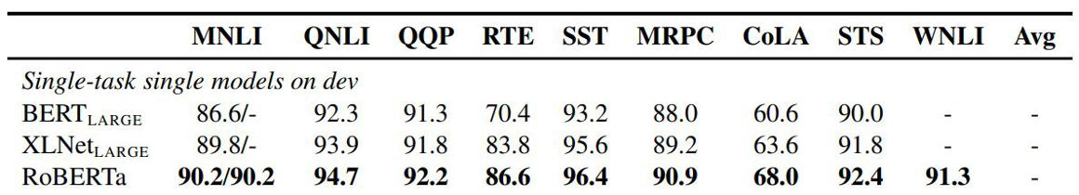
After BERT - RoBERTa
RoBERTa: A Robustly Optimized BERT Pretraining Approach (Liu et al, University of Washington and Facebook, 2019)
Trained BERT for more epochs and/or on more data
Showed that more epochs alone helps, even on same data
More data also helps
Masking and pre-training data slightly improved

Slide 4
After BERT - XLNet
Generalized Autoregressive Pretraining for Language Understanding (Yang et al, CMU and Google, 2019)
Innovation #1: Relative position embeddings
Sentence: John ate a hot dog
Absolute attention: “How much should dog attend to hot (in any position), and how much should dog in position 4 attend to the word in position 3? (Or 508 attend to 507, …)”
Relative attention: “How much should dog attend to hot (in any position) and how much should dog attend to the previous word?”
Innovation #2: Permutation Language Modeling
In a left-to-right language model, every word is predicted based on all of the words to its left
Instead: Randomly permute the order for every training sentence
Equivalent to masking, but many more predictions per sentence
Can be done efficiently with Transformers

Slide 5
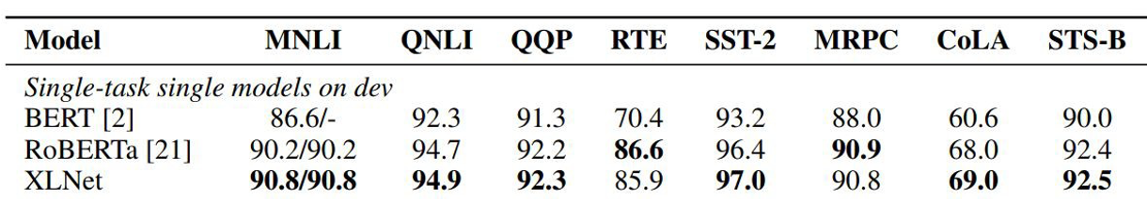
After BERT - XLNet
Also used more data and bigger models, but showed that innovations improved on BERT even with same data and model size

Slide 6
After BERT - ALBERT
ALBERT: A Lite BERT for Self-supervised Learning of Language Representations (Lan et al, Google and TTI Chicago, 2019)
Innovation #1: Factorized embedding parameterization
Innovation #2: Cross-layer parameter sharing Share all parameters between Transformer layers
ALBERT is light in terms of parameters, not speed

Slide 7
After BERT - T5
Exploring the Limits of Transfer Learning with a Unified Text-to-Text Transformer (Raffel et al, Google, 2019)
Ablated many aspects of pre-training:
Model size Amount of training data
Domain/cleanness of training data
Pre-training objective details (e.g., span length of masked text)
Ensembling Finetuning recipe (e.g., only allowing certain layers to finetune)
Multi-task training
Scaling up model size and amount of training data helps a lot
Best model is 11B parameters (BERT-Large is 330M), trained on 120B words of cleaned common crawl text
Exact masking/corruptions strategy doesn’t matter that much
Mostly negative results for better finetuning and multi-task strategies

Slide 8
After BERT - ELECTRA
ELECTRA: Pre-training Text Encoders as Discriminators Rather Than Generators (Clark et al, 2020)
Train model to discriminate locally plausible text from real text

Slide 9
After BERT: Distillation
Distillation (a.k.a., model compression)
Idea has been around for a long time:
Model Compression (Bucila et al, 2006)
Distilling the Knowledge in a Neural Network (Hinton et al, 2015)
Simple technique: Train “Teacher”: Use SOTA pre-training + fine-tuning technique to train model with maximum accuracy
Label a large amount of unlabeled input examples with Teacher
Train “Student”: Much smaller model (e.g., 50x smaller) which is trained to mimic Teacher output
Student objective is typically Mean Square Error or Cross Entropy

Slide 10
After BERT: Distillation
Finetuning mostly just picks up and tweaks existing latent features
This requires an oversized model, because only a subset of the features are useful for any given task
Distillation allows the model to only focus on those features
Supporting evidence: Simple self-distillation of a small model (e.g., distilling a smaller BERT model) doesn’t work very well

Slide 11
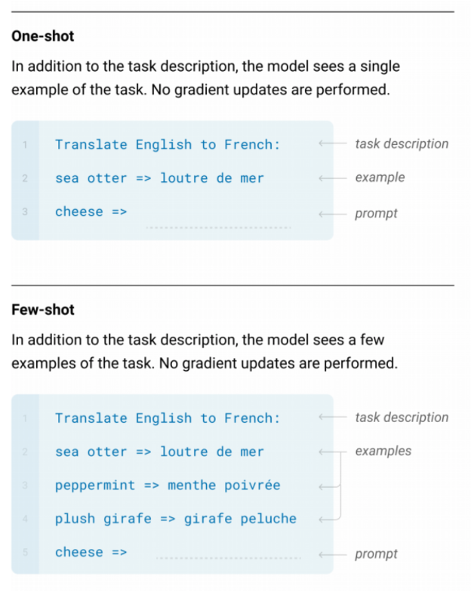
LLMs - zero- and few-shot learning

Slide 12
LLMs
(very) large language models
Models: GPT, T5, BLOOM,
https://cameronrwolfe.substack.com/p/modern-llms-mt-nlg-chinchilla-gopher
https://cameronrwolfe.substack.com/p/specialized-llms-chatgpt-lamda-galactica
https://twitter.com/cwolferesearch/status/1615826897342013443
Tools & Platforms
ChatGPT,
Transformers (Huggingface)
https://huggingface.co/facebook/bart-large-mnli
Tasks
zero-shot learning
few-shot learning
Simulating public opinion platforms

Slide 13
Thanks for listening!
What questions do you have?
Reach me at: ali.hurriyetoglu@gmail.com

